Slide 1

C# Fundamentals
Course Introduction
SoftUni Team
Technical Trainers
Software University
https://softuni.bg/

Slide 2
Table of Contents
Course Objectives
Training and Team
Course Organization
Course Infrastructure
Evaluation Criteria

Slide 3
Have a Question?
sli.do
#csharp-fund

Slide 4














SoftUni Diamond Partners

Slide 5

Course Objectives

Slide 6
C# Fundamentals Objectives
Working with linear data structures
Arrays and Lists
Defining simple classes
Processing and manipulating strings
Regular expressions
Building а simple web project

Slide 7
Practical Programming Exam
Mid Exam
3 practical problems for 4 hours
Conditional Statements and Loops
Arrays
Lists
Final Exam
3 practical problems for 4 hours
Associative Arrays
Strings and Text Processing
Regular Expressions

Slide 8
Theoretical Exam
You will have 30 minutes once you enter
Multiple-choice with 1 or more correct answers
English
Automated quiz system
Available during the practical exam and 30 minutes after it
You can submit your answers just one time
Advice: Start it when you finish the practical exam

Slide 9

Course Organization

Slide 10
C# Fundamentals Module
14-Sept-2020
07-Nov-2020
13-Dec-2020
20-Dec-2020
C# Fundamentals
12 weeks * 3 times / week 18 credits
Start: 14-Sept-2020
Mid Exam: 07-Nov-2020
Theoretical Exam: 13-Dec-2020
Final exam: 13-Dec -2020
Re-Take Exams
Mid Exam Retake: 17-Dec-2020
Тheoretical Exam: 20-Dec-2020
Final Exam Retake : 20-Dec-2020

Slide 11

Homework Assignments & Exercises
Your homework is mainly work in class
Lesson days → slides + live demos + exercises
Exercise days → only exercises
How to submit your homework?
Submitted in the judge system
Do your homework when it's due
Assignments pile up quickly

Slide 12


SoftUni Certificate
Practical Exam 100%
Homework 5%
Evaluation
12

Slide 13
CPE Certificate
Theoretical Exam 100%
Evaluation
13

Slide 14

The Team

Slide 15
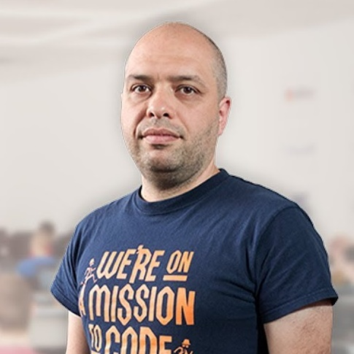
Stamo Petkov
Head Of Department at Information Services Plc.
Worked with various technologies
.NET and C#, BASIC, Pascal, Object Pascal, PHP
More than 15 years of experience
Experienced Lecturer
C# Basics and ASP.NET MVC @ Softuni

Slide 16
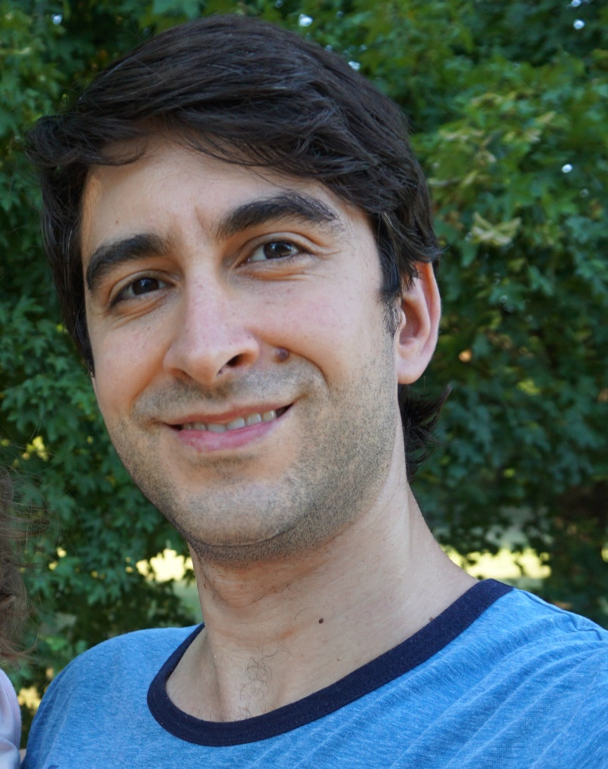
Alexander Kermanov
Part of SoftUni International
Law Graduate from UNWE
Completed the C# Path
Has interests in JS, long walks and fishing

Slide 17


Course Web Site, Forum and FB Group
Official web site:
Official discussion forum:
C# Fundamentals Facebook group:
https://softuni.bg/modules/106/fundamentals-module/1259
softuni.bg/forum/categories/44
facebook.com/groups/FundamentalsModuleSeptember2020/

Slide 18
Questions?
Notes:
18

Slide 19
Trainings @ Software University (SoftUni)
Software University – High-Quality Education, Profession and Job for Software Developers
softuni.bg, about.softuni.bg
Software University Foundation
softuni.foundation
Software University @ Facebook
facebook.com/SoftwareUniversity
Software University Forums
forum.softuni.bg
Notes:
19

Slide 20

License
This course (slides, examples, demos, exercises, homework, documents, videos and other assets) is copyrighted content
Unauthorized copy, reproduction or use is illegal
© SoftUni – https://about.softuni.bg/
© Software University – https://softuni.bg
Notes:
20

